Slide 1
Lecture 0 CSC 111 Course Overview
Zonghua Gu
Department of Computer Science
Hofstra University

Slide 2
Course Logistics
Instructor: Dr. Zonghua Gu
Email: Zonghua.Gu@hofstra.edu
Office: SIC 219
Office hours: Thur 2:00-6:00 pm
Course website: https://guhofstra.github.io/CSC111Sp25/
Lectures:
SIC 200, TR 6:00 PM-7:25 PM

Slide 3
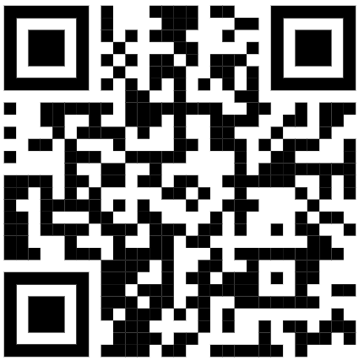
Discord Channel and Feedback Form
Join the Discord channel: https://discord.gg/S9bdAhq5za
IMPORTANT! Used for all announcements and online Q&A
Course tutor
Samson Mathew smathew5@pride.hofstra.edu
Available on discord and on-demand ZOOM meetings
Use the anonymous feedback form anytime to provide your comments and suggestions for me.

Slide 4
No Textbook
No required textbook. Exams are based on lecture slides only
Reference book:
Embedded Systems with ARM Cortex-M Microcontrollers in Assembly Language and C, University of Maine https://web.eece.maine.edu/~zhu/book/
Tentative Topics (subject to change)
Introduction to load/store computation model
Data representation, carry & overflow
Memory addressing, endianness, data alignment
Fixed-point arithmetic implementation
ARM assembly instructions: arithmetic and logic operations, memory I/Os, and flow control
Subroutines: three approaches to pass parameters via reference, registers and stack in ARM assembly
Mixing C and ARM assembly: C codes call assembly codes, and assembly codes call C codes.
Hardware and software Interrupts, and interrupt service routine
Interfacing to general-purpose I/Os, programming timer module to perform input capture and output compare
Notes:
Recommended book: Algorithms, 4th Edition by Robert Sedgewick and Kevin Wayne.

Slide 5
Lab Assignments
Lab assignments under construction
Please sign up on Canvas to form groups of 1-3 students each
Based on Raspberry PI 4B. Each group will be given one, and we will work on it during class
Late Days: Each student is allowed a total of 3 late days for this class, which may be spent in units of one day (24 hours) on any project(s) throughout the semester. Once your late days have been used up, late work will not receive any credit. Late days are intended to handle all issues, including unexpected problems such as illness.

Slide 6
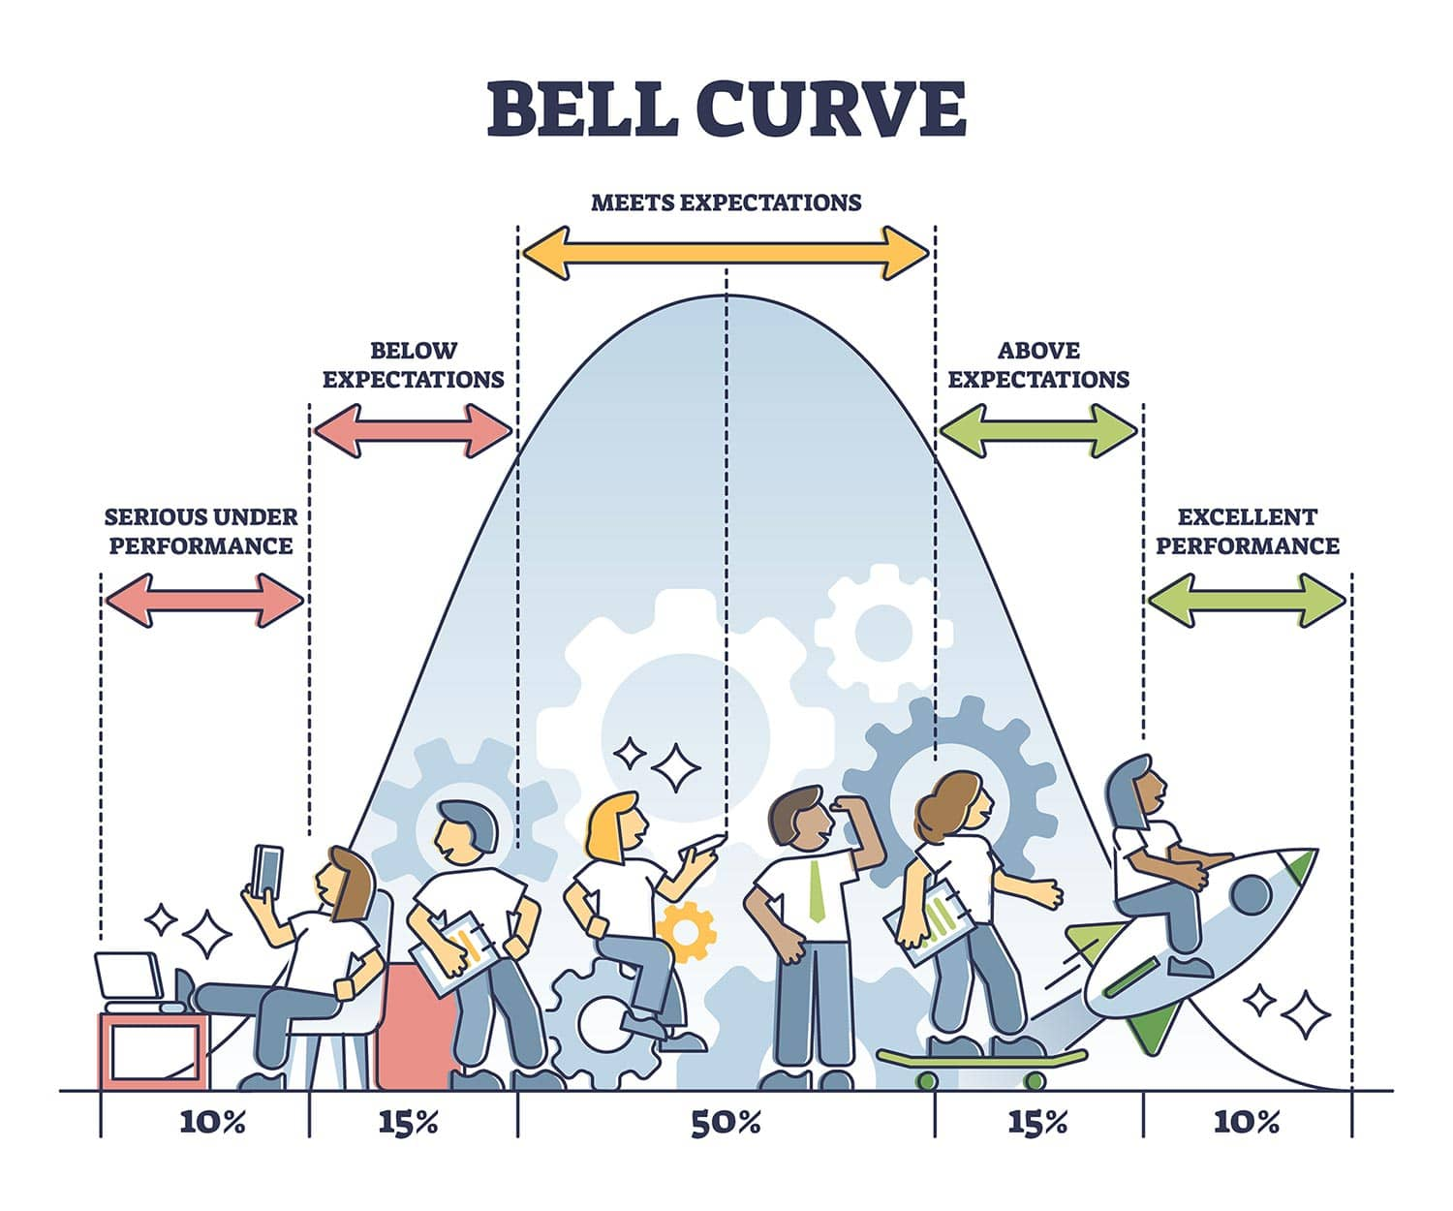
Grading Policy
Midterm exam: 30%
Final exam: 40%
Labs: 30%
Graded on a curve based on the final points
Absolute marks do not matter, but your relative ranking in the class determines your final letter grade
F?
C
B
A
Notes:
https://www.simplypsychology.org/normal-distribution.html

